Slide 1
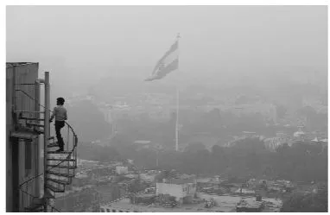
Delhi Weather Forecasting

Slide 2
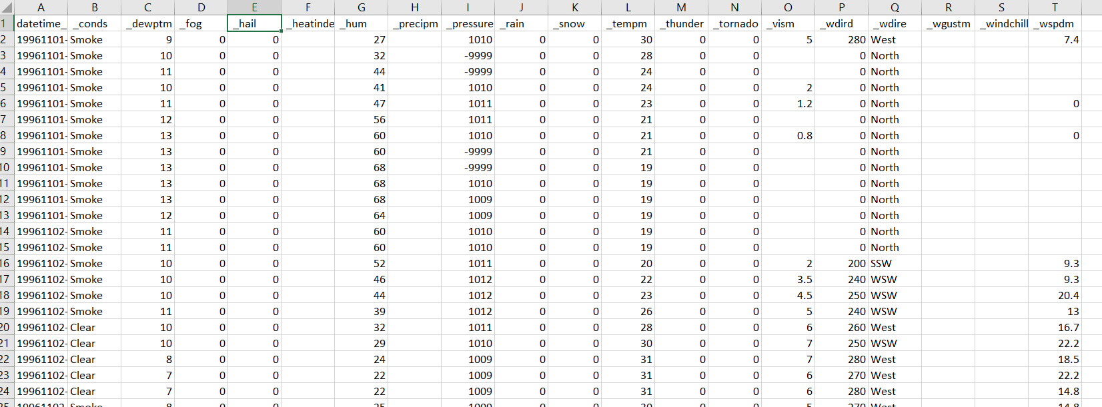

Slide 3
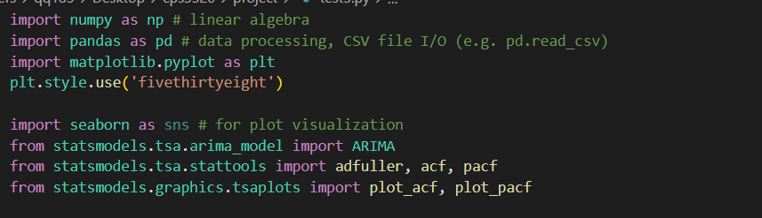
Library we use

Slide 4
ARIMA
An autoregressive integrated moving average, or ARIMA, is a statistical analysis model that uses time series data to either better understand the data set or to predict future trends.
A statistical model is autoregressive if it predicts future values based on past values. For example, an ARIMA model might seek to predict a stock's future prices based on its past performance or forecast a company's earnings based on past periods.
KEY TAKEAWAYS
Autoregressive integrated moving average (ARIMA) models predict future values based on past values.
ARIMA makes use of lagged moving averages to smooth time series data.
They are widely used in technical analysis to forecast future security prices.
Autoregressive models implicitly assume that the future will resemble the past.
Therefore, they can prove inaccurate under certain market conditions, such as financial crises or periods of rapid technological change.

Slide 5
An autoregressive integrated moving average model is a form of regression analysis that gauges the strength of one dependent variable relative to other changing variables. The model's goal is to predict future securities or financial market moves by examining the differences between values in the series instead of through actual values.
An ARIMA model can be understood by outlining each of its components as follows:
Autoregression (AR): refers to a model that shows a changing variable that regresses on its own lagged, or prior, values.
Integrated (I): represents the differencing of raw observations to allow for the time series to become stationary (i.e., data values are replaced by the difference between the data values and the previous values).
Moving average (MA): incorporates the dependency between an observation and a residual error from a moving average model applied to lagged observations.

Slide 6
Important parameters
p: the number of lag observations in the model; also known as the lag order.
d: the number of times that the raw observations are differenced; also known as the degree of differencing.
q: the size of the moving average window; also known as the order of the moving average.

Slide 7
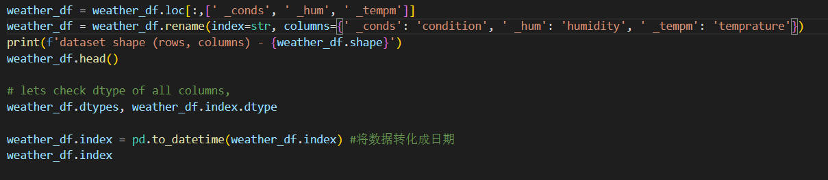
Data preprocessing

Slide 8
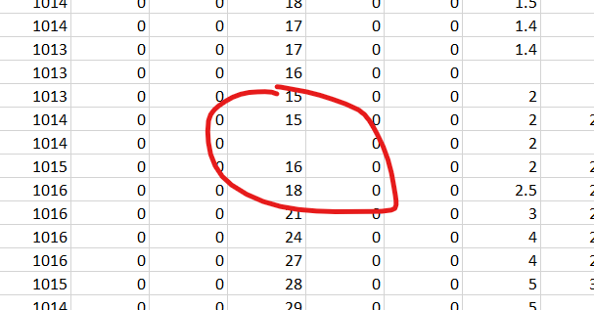

Slide 9
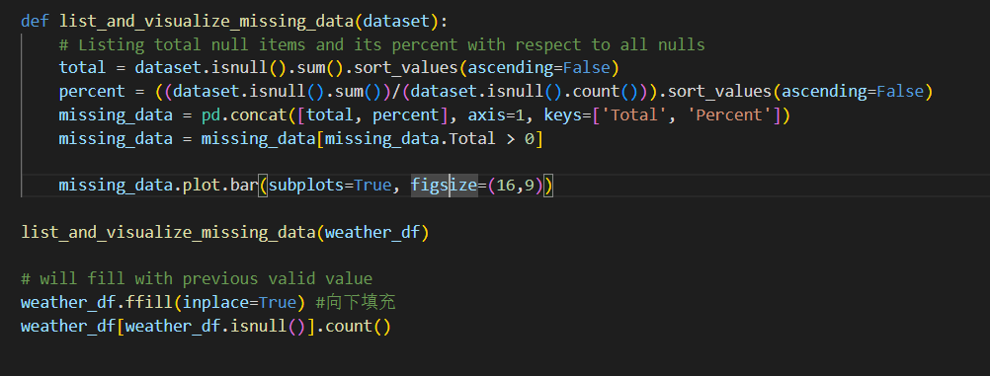
Find missing data

Slide 10
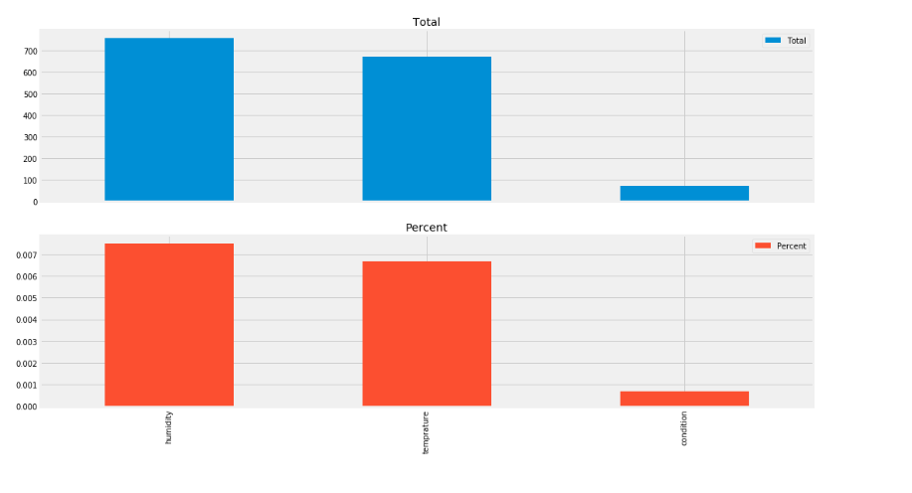

Slide 11
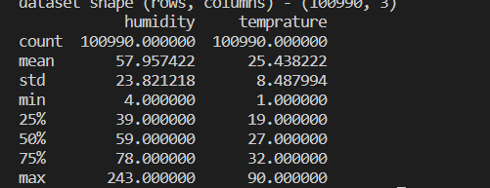


Slide 12
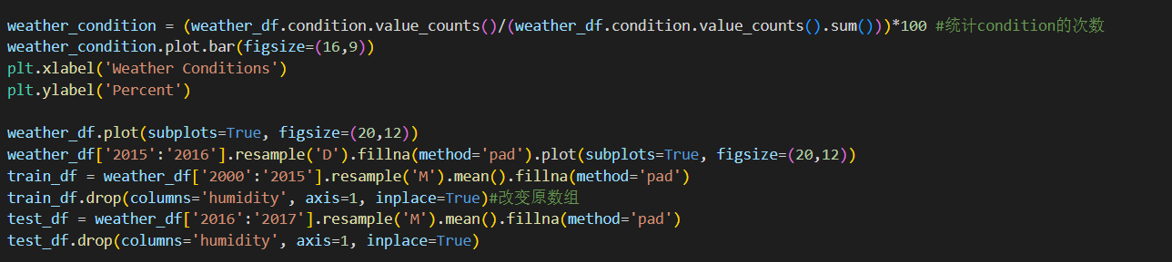

Slide 13
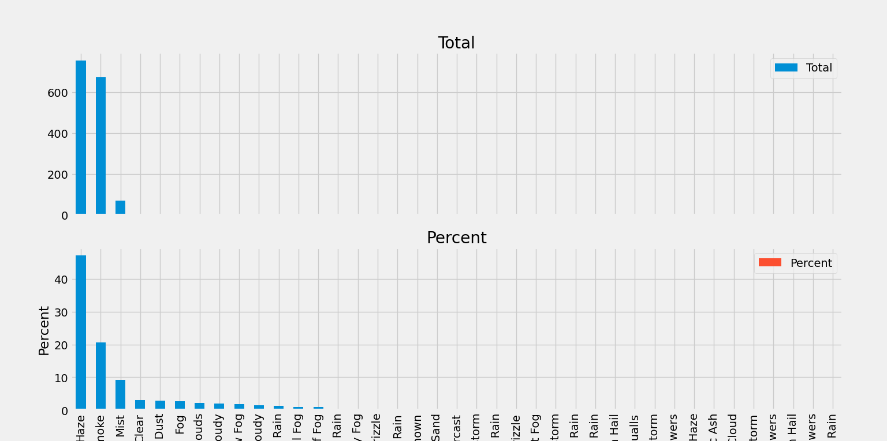

Slide 14
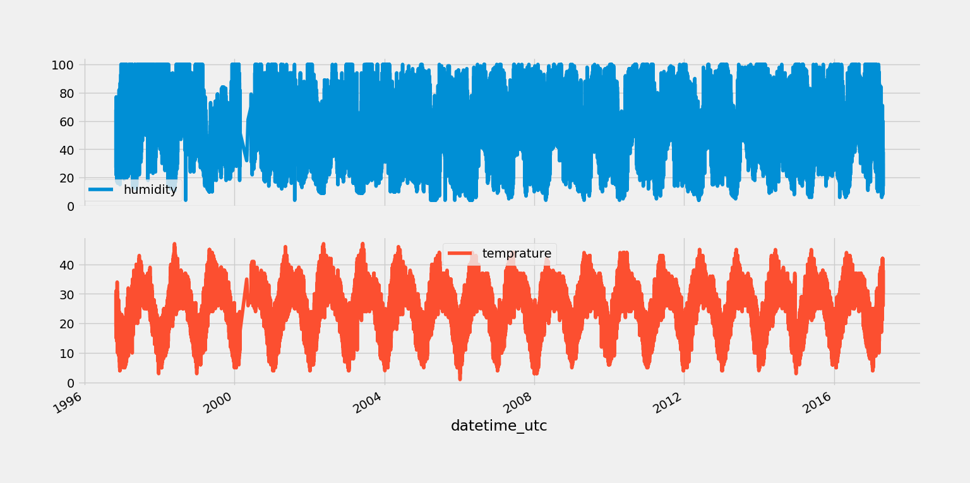

Slide 15
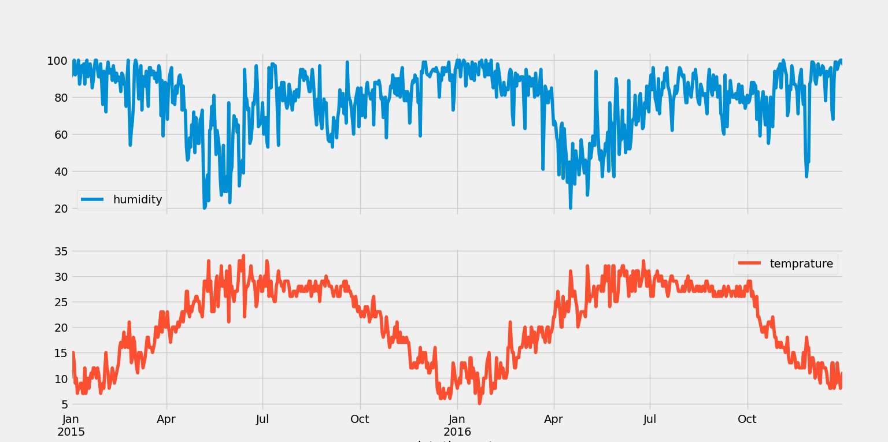

Slide 16
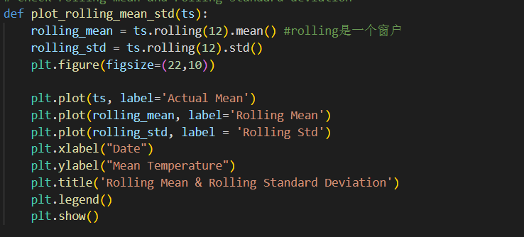

Slide 17
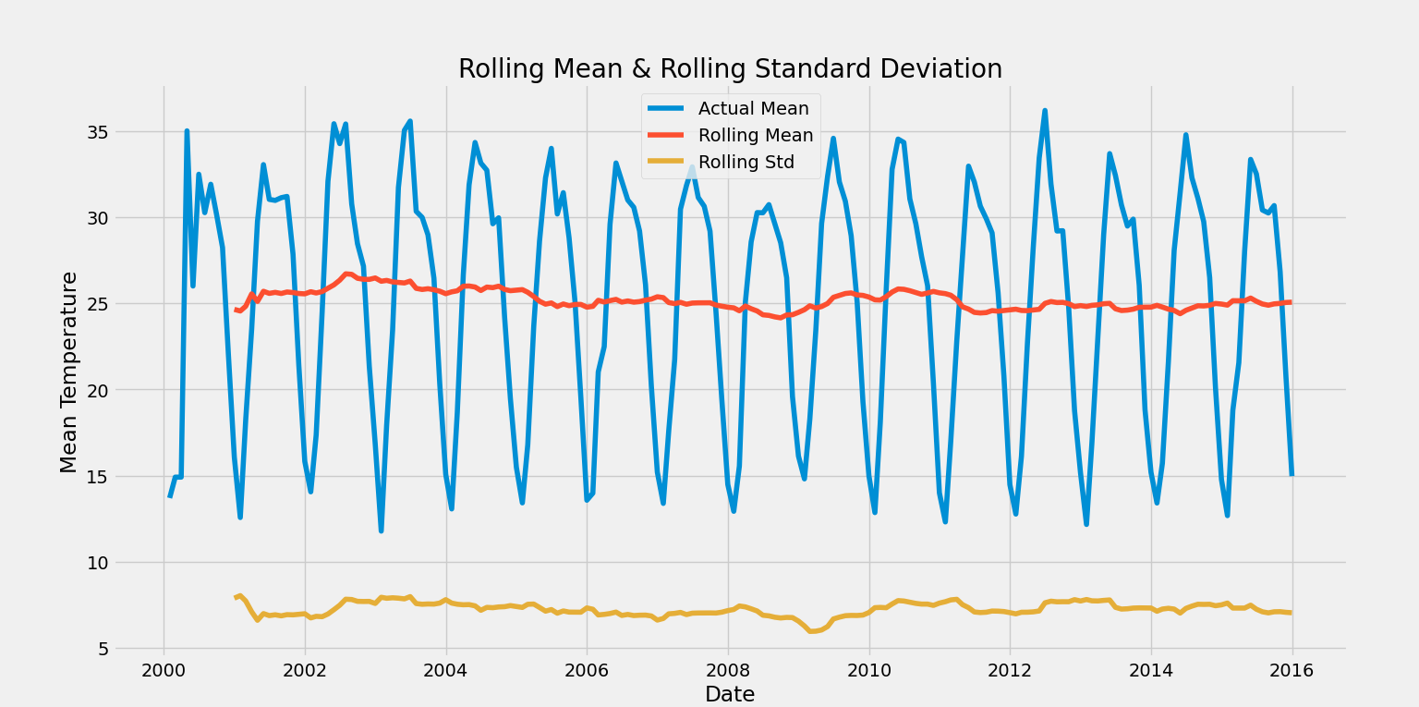

Slide 18
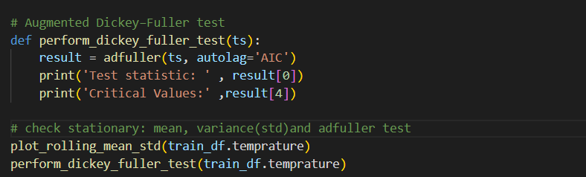

Slide 19
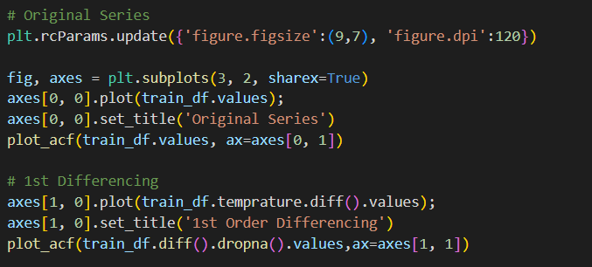
Difficult data treatment part

Slide 20
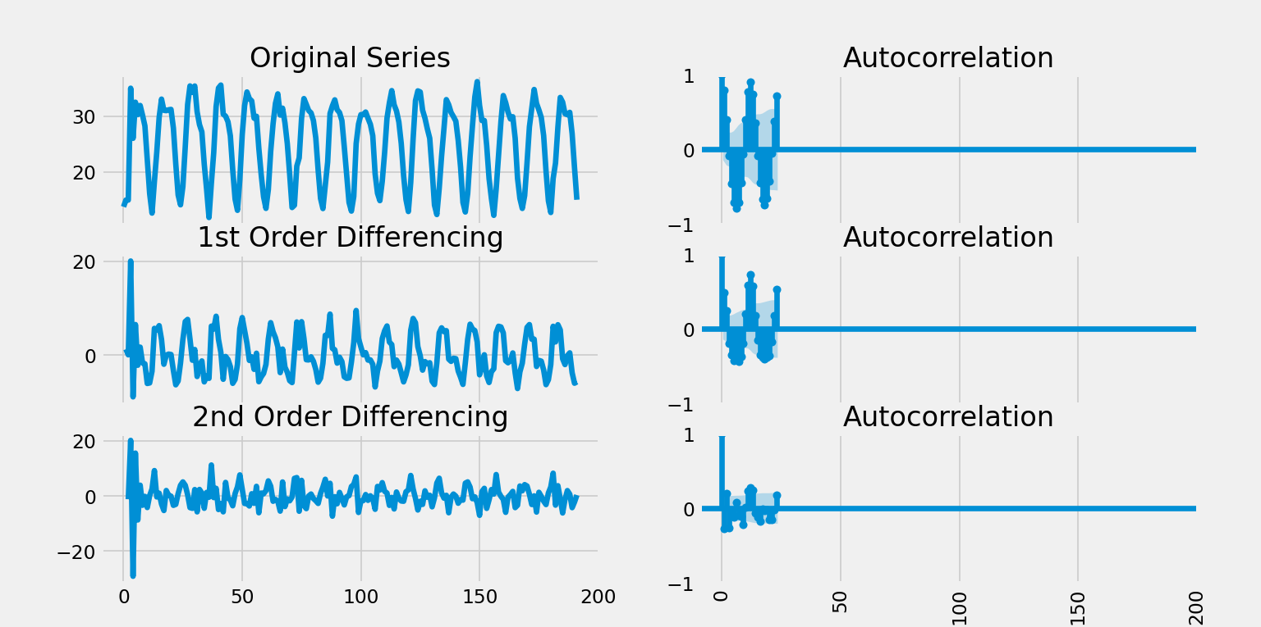

Slide 21
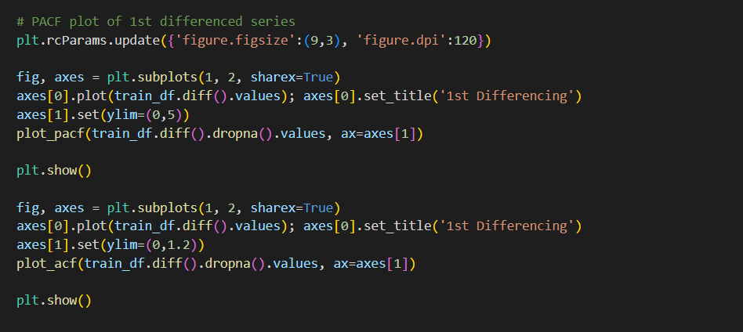
PACF and ACF graph

Slide 22
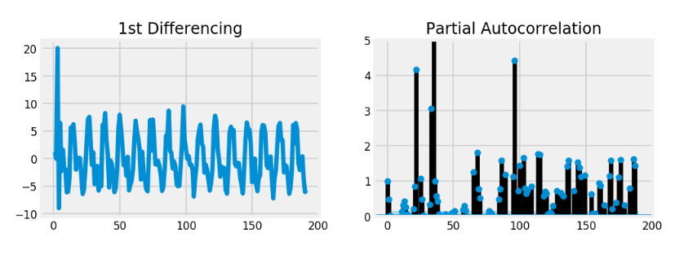
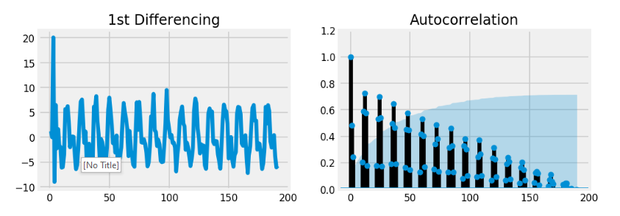

Slide 23
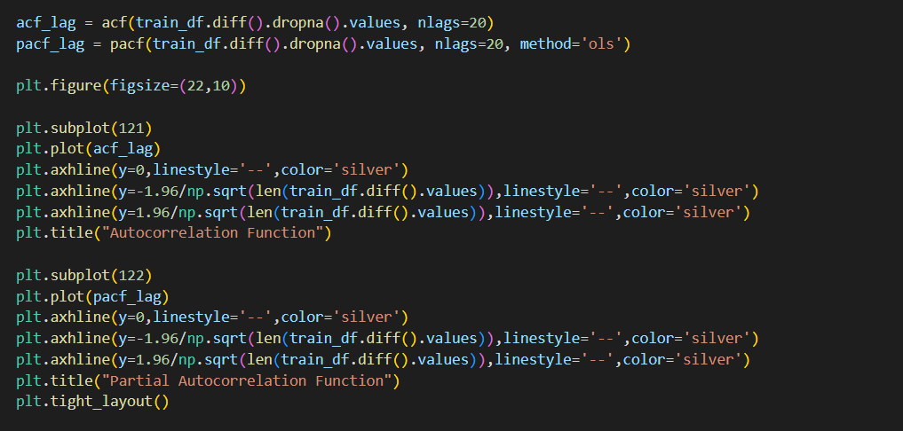
Autocorrelation Function (ACF) and
Partial Autocorrelation Function (PACF)

Slide 24
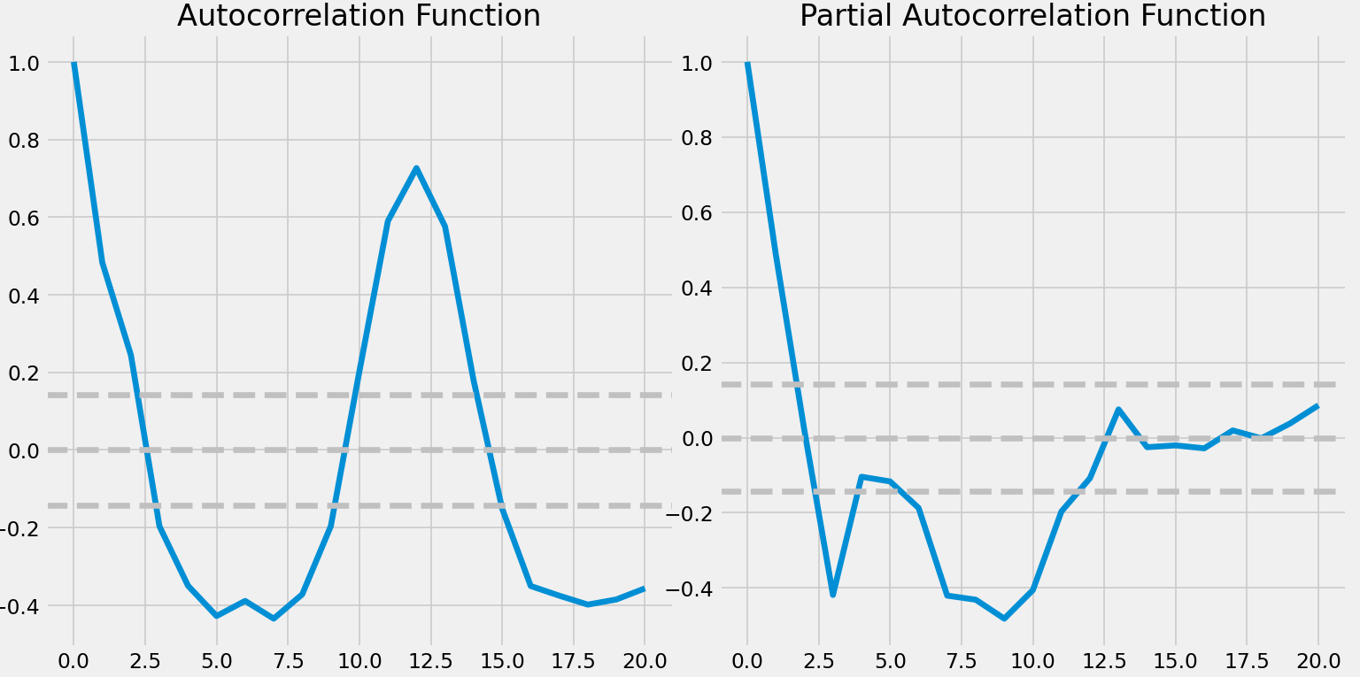

Slide 25
Know the value of parameters
from the graph
These grey dotted line are confidence intervels which we are going to use to find out the value of p and q.
p - the point where PACF crosses the upper confiednce level. In our case it seems to be 2. So we will take p = 2.
q - the point where ACF crosses the upper confiednce level. In our case it seems to be 2. So we will take q = 2.
d - number of nonseasonal differences needed for stationarity. In this case we are going to take it as 0, since this series is already stationary.

Slide 26
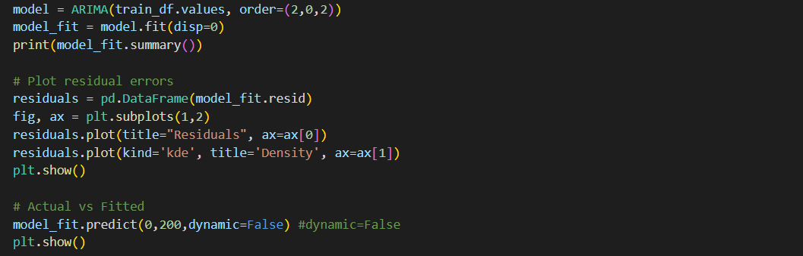
Training part

Slide 27
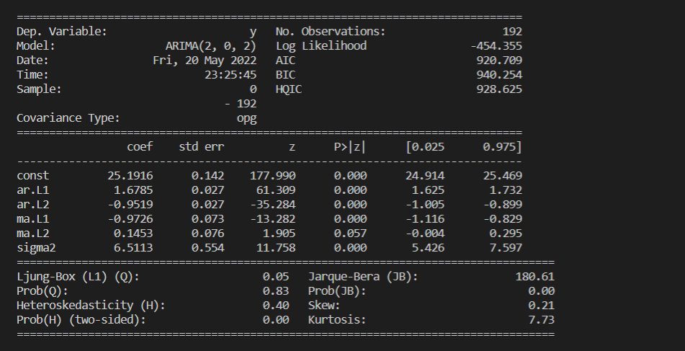

Slide 28
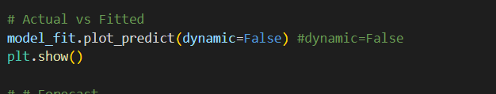
It’s time to see accuracy

Slide 29
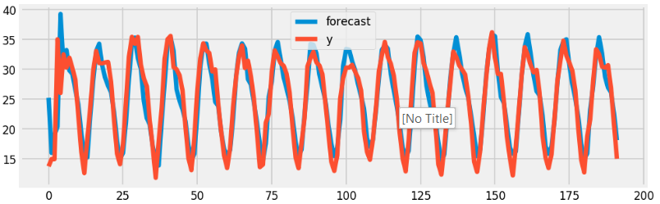
Quite close for the training set

Slide 30
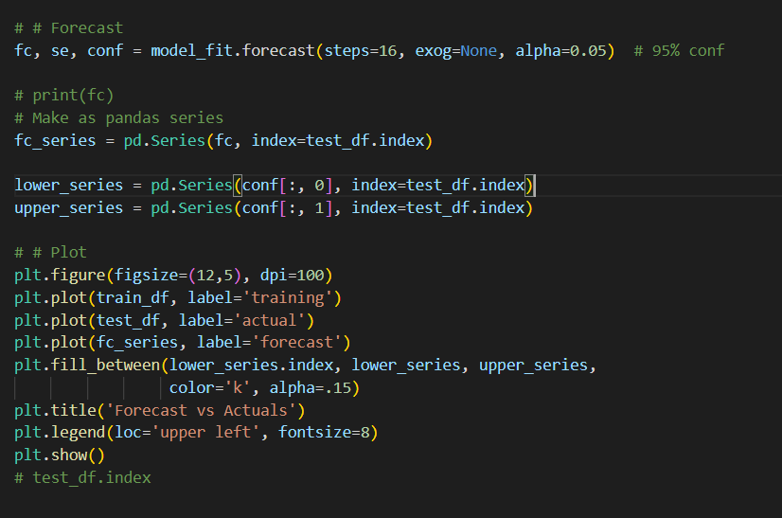
It’s time to see the testing set

Slide 31
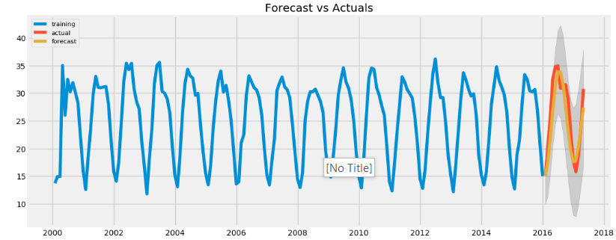
What we get

Slide 32
Thanks

